Slide 1
Predicting telomere maintenance mechanism in H3K27-altered diffuse midline glioma
Galina Glousker, EPFL
CAS ADS Module 5
13.12.24

Slide 2
Paediatric high-grade gliomas
Diffuse Midline Glioma, H3 K27-Altered (CNS WHO Grade 4): Characterized by mutations in histone H3 genes (e.g., H3 K27M) or other alterations affecting the same pathway. Commonly located in midline structures such as the thalamus, brainstem, and spinal cord.
Diffuse Hemispheric Glioma, H3 G34-Mutant (CNS WHO Grade 4): Harbors mutations in the H3F3A gene leading to the G34R/V alteration. Typically arises in the cerebral hemispheres of adolescents and young adults.
Diffuse Pediatric High-Grade Glioma, H3/IDH-Wildtype (CNS WHO Grade 4): Lacks mutations in both histone H3 and IDH genes. Represents a heterogeneous group requiring further molecular characterization.

Slide 3
Telomeres in cancer development

Slide 4
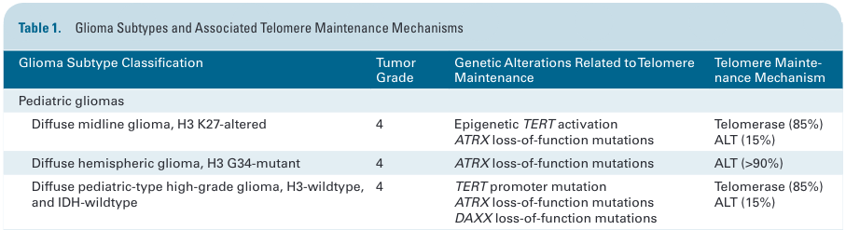
Telomere maintenance in pHGG
Increased expression of telomerase components is associated with worse overall survival in patients with non-brainstem HGGs
Same study found evidence of ALT in both non-brainstem HGG and DIPG specimens
There is significant interest in targeting TMMs for glioma therapy
https://doi.org/10.1093/neuonc/noae016

Slide 5
Aim of the project
Profile and characterise ALT in pHGG
Examine whether ALT is associated with recurrent somatic or germline alterations in pHGG
Build genomic classifier to predict ALT status using low-coverage WGS, WES, Nanopore 30x long-read WGS, and mRNA-seq data

Slide 6
Materials and Data
Patients-derived 30 primary H3K27M-mutant DMG and 10 H3WT pHGG cell lines:
Whole exome sequencing
Low coverage (4-6x) whole genome sequencing
Nanopore long-read (30x) whole genome sequencing
mRNA sequencing
Sequencing was performed in Health2030 Genome Center (Geneva)

Slide 7
Metadata and Data quality
Metadata:
Sample Metadata: Details about the cell line
Experimental Metadata:
Preparation Methods: library preparation, sequencing
Instrument Details: Specifications of the sequencing platforms, configuration settings
Sequencing Parameters: Information on read length, sequencing depth, and any multiplexing strategies used
QC:
MultiQC-based quality control
Sample contamination (VerifyBamID)
Sample relatedness (Somalier)

Slide 8
Data flow
Preprocessing:
Read alignment
Variant calling: SNV, MNV, indel, and SV calling
Complete genome based on integration of WES, WGS, and Nanopore
Feature Engineering:
Identify and quantify genomic features indicative of ALT status (specific mutations, structural variants, gene expression levels of ALT-associated genes, telomere length estimation, PGS)
Modelling:
Logistic Regression, k-NN, Knowledge-Slanted Random Forest
Performance metrics: accuracy, precision, recall, F1 score, AUC-ROC
Evaluation:
? Publicly available dataset (Generating synthetic missing data using distributions learned from the external dataset for overlapping features)
Notes:
knowledge-slanted RF that integrates biological networks as prior knowledge into the model to improve its performance and explainability, exemplifying its use for selecting and identifying relevant genes. knowledge-slanted RF is a combination of two stages. First, prior knowledge represented by graphs is translated by running a random walk with restart algorithm to determine the relevance of each gene based on its connection and localization on a protein-protein interaction network. Then, each relevance is used to modify the selection probability to draw a gene as a candidate split-feature in the conventional RF. Experiments in simulated datasets with very small sample sizes (n≤30) comparing knowledge-slanted RF against conventional RF and logistic lasso regression, suggest an improved precision in outcome prediction compared to the other methods

Slide 9
Data flow
Preprocessing:
Read alignment
Variant calling: SNV, MNV, indel, and SV calling
Complete genome based on integration of WES, WGS, and Nanopore
Notes:
knowledge-slanted RF that integrates biological networks as prior knowledge into the model to improve its performance and explainability, exemplifying its use for selecting and identifying relevant genes. knowledge-slanted RF is a combination of two stages. First, prior knowledge represented by graphs is translated by running a random walk with restart algorithm to determine the relevance of each gene based on its connection and localization on a protein-protein interaction network. Then, each relevance is used to modify the selection probability to draw a gene as a candidate split-feature in the conventional RF. Experiments in simulated datasets with very small sample sizes (n≤30) comparing knowledge-slanted RF against conventional RF and logistic lasso regression, suggest an improved precision in outcome prediction compared to the other methods

Slide 10
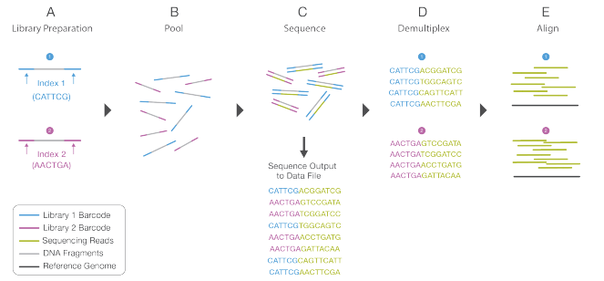
Illumina sequencing workflow
https://www.illumina.com

Slide 11
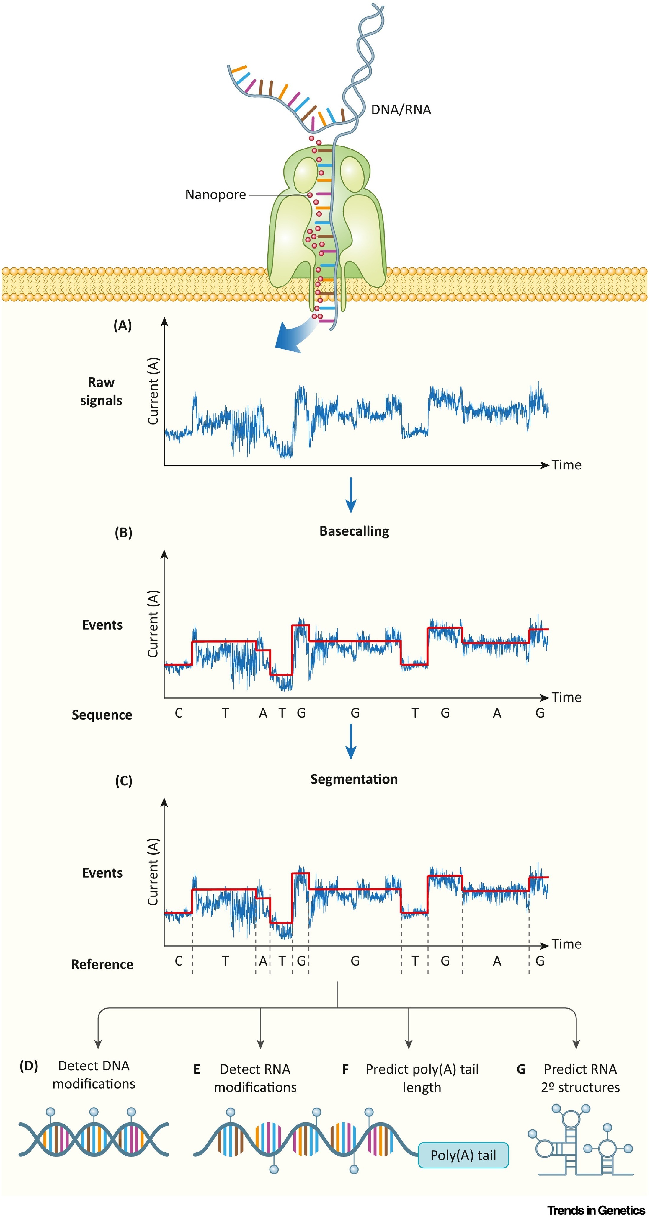
Nanopore sequencing workflow
Basecalling

Slide 12
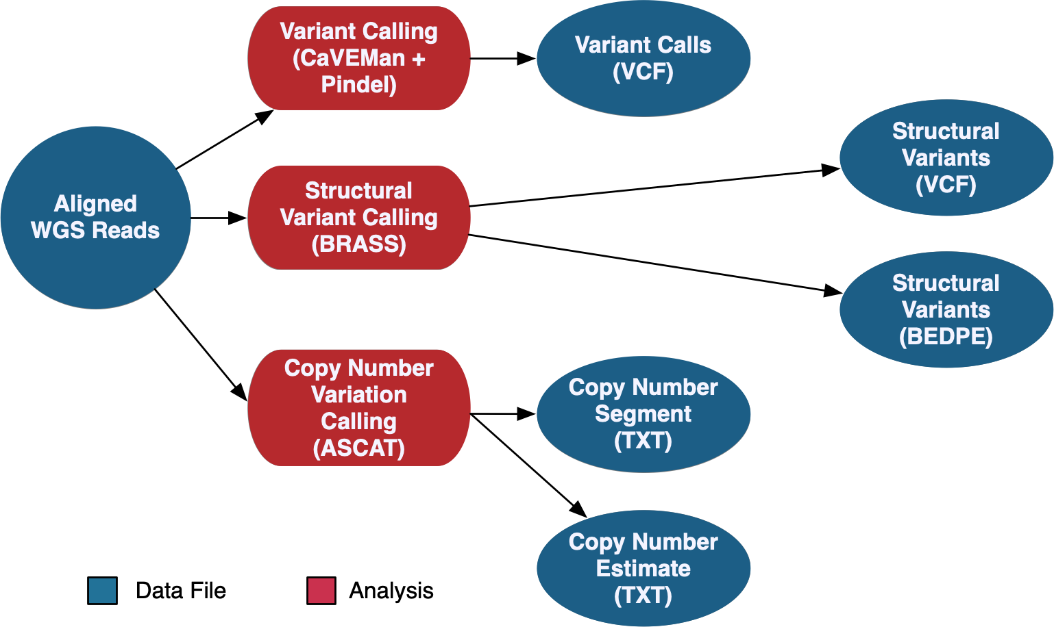
Variant calling
https://gdc.cancer.gov/system/files/public/image/WGS-Sanger-DR28.png

Slide 13
Data flow
Feature Engineering:
Identify and quantify genomic features indicative of ALT status (specific mutations, structural variants, gene expression levels of ALT-associated genes, telomere length estimation, PGS)
Notes:
knowledge-slanted RF that integrates biological networks as prior knowledge into the model to improve its performance and explainability, exemplifying its use for selecting and identifying relevant genes. knowledge-slanted RF is a combination of two stages. First, prior knowledge represented by graphs is translated by running a random walk with restart algorithm to determine the relevance of each gene based on its connection and localization on a protein-protein interaction network. Then, each relevance is used to modify the selection probability to draw a gene as a candidate split-feature in the conventional RF. Experiments in simulated datasets with very small sample sizes (n≤30) comparing knowledge-slanted RF against conventional RF and logistic lasso regression, suggest an improved precision in outcome prediction compared to the other methods

Slide 14
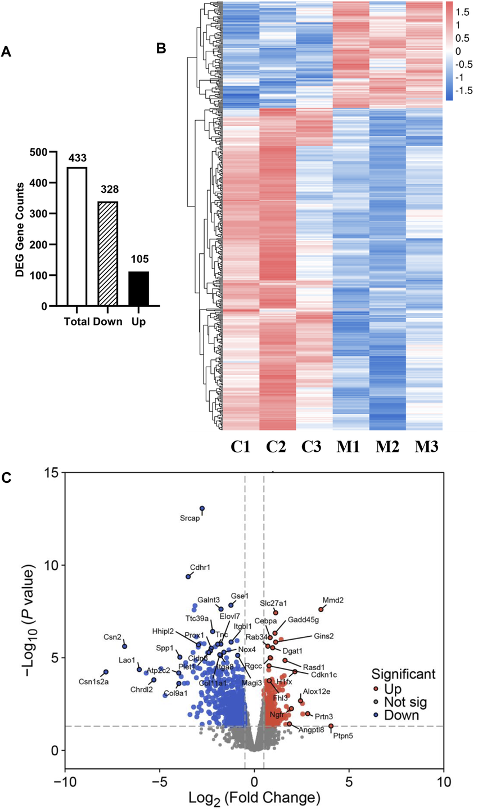
Gene expression analysis

Slide 15
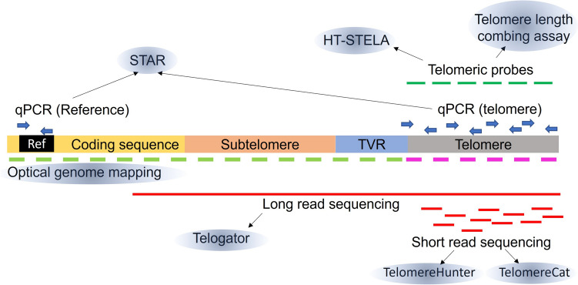
Telomere length estimation
Telometer
Telomere hunter
TelSeq
10.1007/s11899-023-00717-4

Slide 16
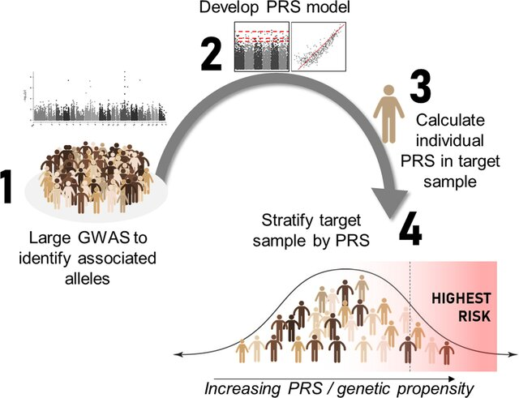
Polygenic score calculation
10.1186/s40337-022-00578-x

Slide 17
Data flow
Modelling:
Logistic Regression, k-NN, Knowledge-Slanted Random Forest
Performance metrics: accuracy, precision, recall, F1 score, AUC-ROC
Evaluation:
? Publicly available dataset (Generating synthetic missing data using distributions learned from the external dataset for overlapping features)
Notes:
knowledge-slanted RF that integrates biological networks as prior knowledge into the model to improve its performance and explainability, exemplifying its use for selecting and identifying relevant genes. knowledge-slanted RF is a combination of two stages. First, prior knowledge represented by graphs is translated by running a random walk with restart algorithm to determine the relevance of each gene based on its connection and localization on a protein-protein interaction network. Then, each relevance is used to modify the selection probability to draw a gene as a candidate split-feature in the conventional RF. Experiments in simulated datasets with very small sample sizes (n≤30) comparing knowledge-slanted RF against conventional RF and logistic lasso regression, suggest an improved precision in outcome prediction compared to the other methods

Slide 18
Methods
Alignment: bwa mem (WES/WGS) and minimap2 (Nanopore)
Somatic and germline variant calling: Strelka2
Telomere length estimation: TelSeq (WES/WGS), Telomere Hunter (WGS), Telometer (Nanopore WGS)
PGS Catalog Calculator (pgsc_calc) to estimate polygenic score for telomere length based on SNPs known to affect telomere length in blood
Python libraries: NumPy, Matplotlib, …, SHAP, Scikit-learn, PyTorch
AI-based methods for Nanopore WGS data (Dorado, Bonito)

Slide 19
Timeline
Preprocessing:
Read alignment
Variant calling: SNV, MNV, indel, and SV calling
Complete genome
Feature Engineering:
Identify and quantify genomic features indicative of ALT status (specific mutations, structural variants, gene expression levels of ALT-associated genes, telomere length estimation, PGS)
Modelling:
Logistic Regression, k-NN, Knowledge-Slanted Random Forest
Performance metrics: accuracy, precision, recall, F1 score, AUC-ROC
Evaluation:
Publicly available dataset (Generating synthetic missing data using distributions learned from the external dataset for overlapping features)
January-February 2025
January-March 2025
March-May 2025

